Slide 1
Team Android
CSCI 430

Slide 2
GroupR

Slide 3
Purpose
A web based organizer to assist in group activity and scheduling for events and meetings
This project was developed because it was a necessity

Slide 4
GroupR
Simple System that controls Group Activity
Schedules
Files
Communications
Events
Secure and Organized

Slide 5
Usefulness
Web Based
File Containment
Calendar
Ethical and Bug Free

Slide 6
Teamwork and Development
Open Repository Master
Branch Method Development
Work Loads Divided
Strong Communication

Slide 7
Design
Mutliple Languages
CSS, HTML, SQL, PHP
Structured with MVC methods
Database structured on
Local Host
School Host

Slide 8
Code Use
Reusable
HTML was recycled to keep WebPages uniform
Database Structure used Dynamically to instantiate more Tables for future Groups
Maintenance
CSS page makes it easy to edit Look and Feel
Database was made easy to edit
Dynamic Development of Groups

Slide 9
Road Blocks
The Group in Early Stages
Lack of Communication
Idea Changes
Complete flip in Week 4

Slide 10
Road Blocks
Server
Development halted because of School Framework
Programing shift because of update concerns
Database Organization
prebuilt data tables no longer worked with language change
All code had to be reviewed and altered

Slide 11
Road Blocks
Small Workloads
Database structures were important to whole project and development was slow because of continuous block
CSS and HTML pages were completed relatively quickly
Specializations
with the use of many languages we became specialized

Slide 12
The Website
Structured with an MVC architecture
Utilizes parsing systems to organize database tables
Encrypted for Security (although out of date)
Near Full Functionality

Slide 13
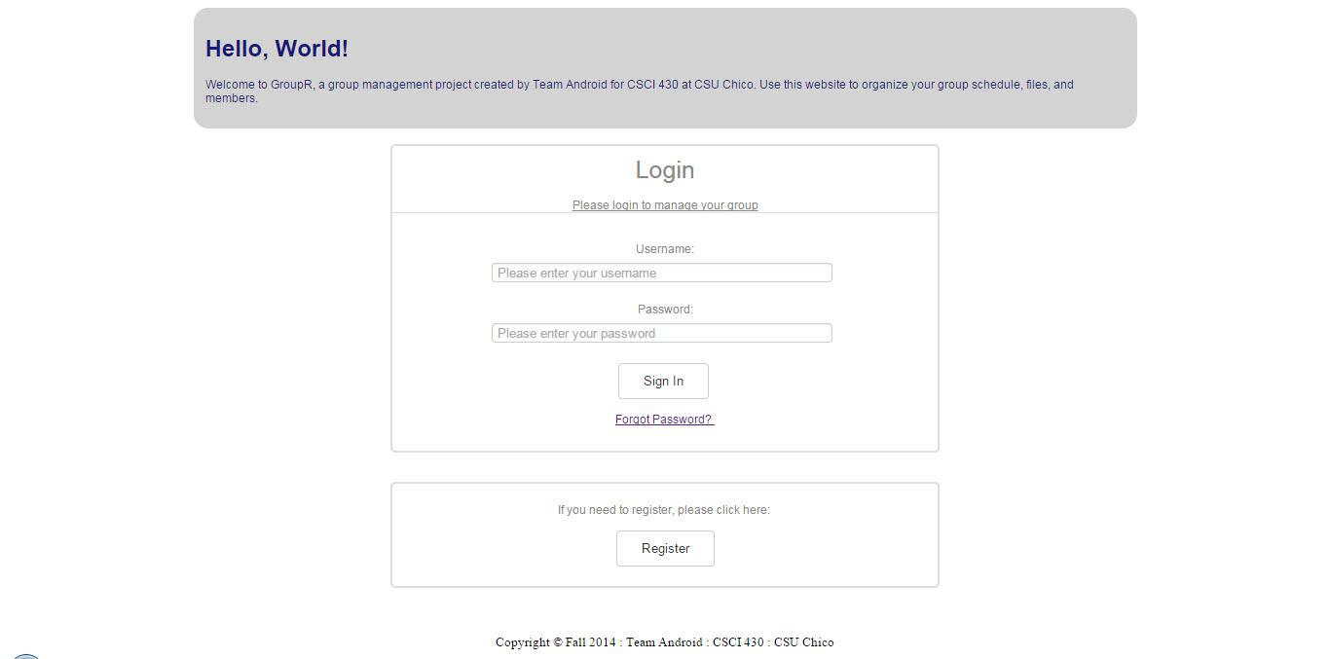

Slide 14
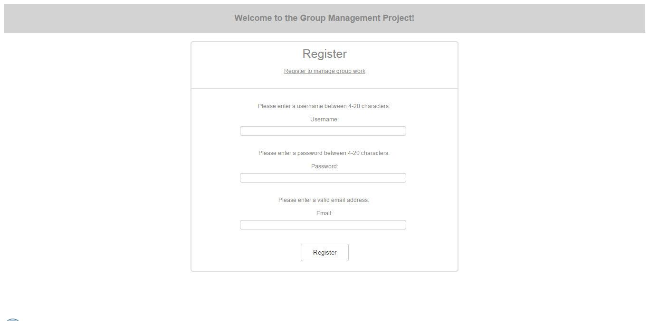

Slide 15
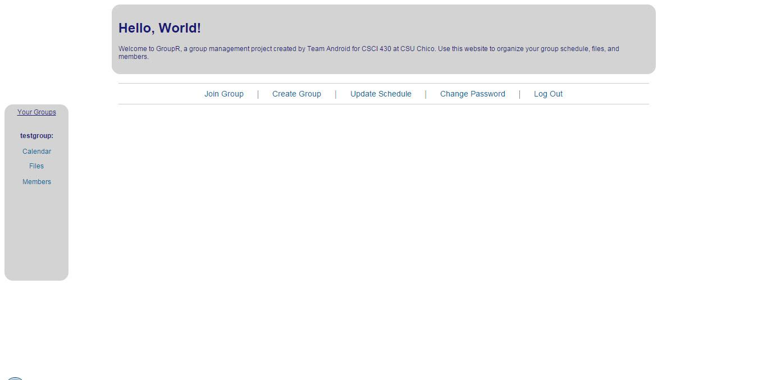

Slide 16
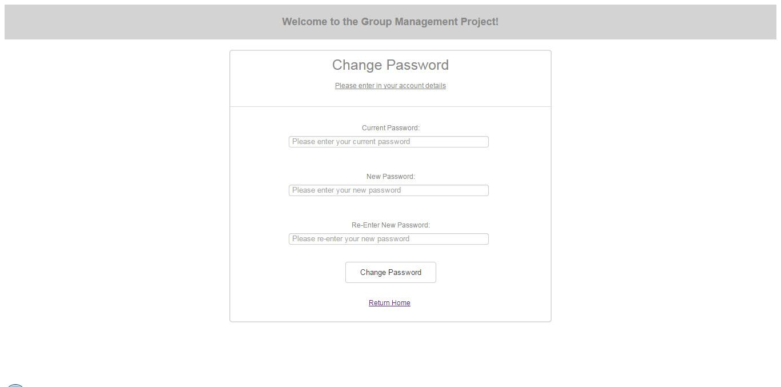

Slide 17
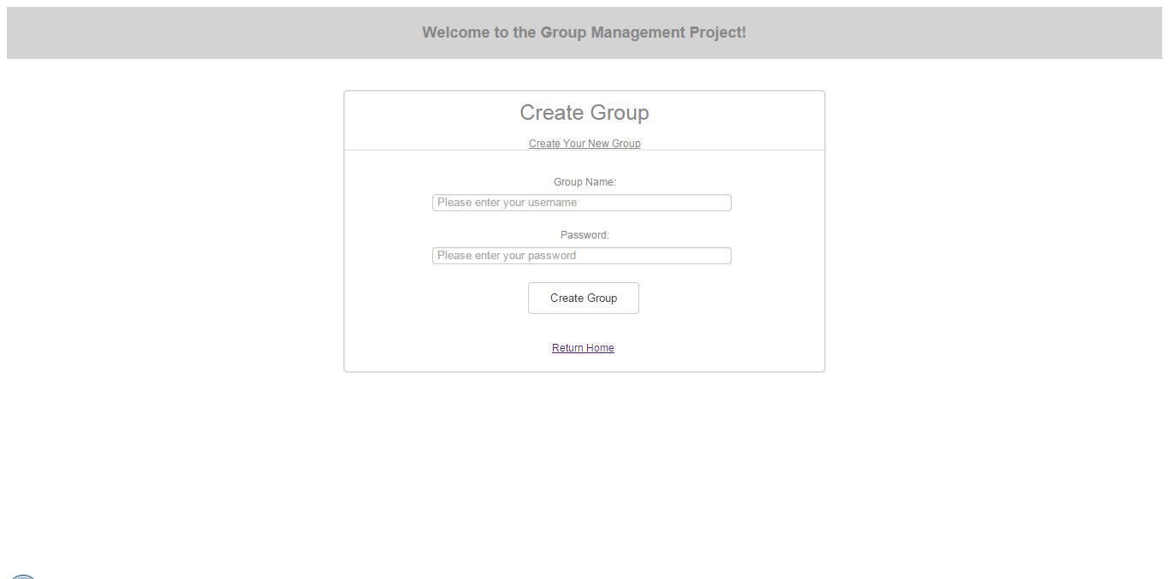

Slide 18
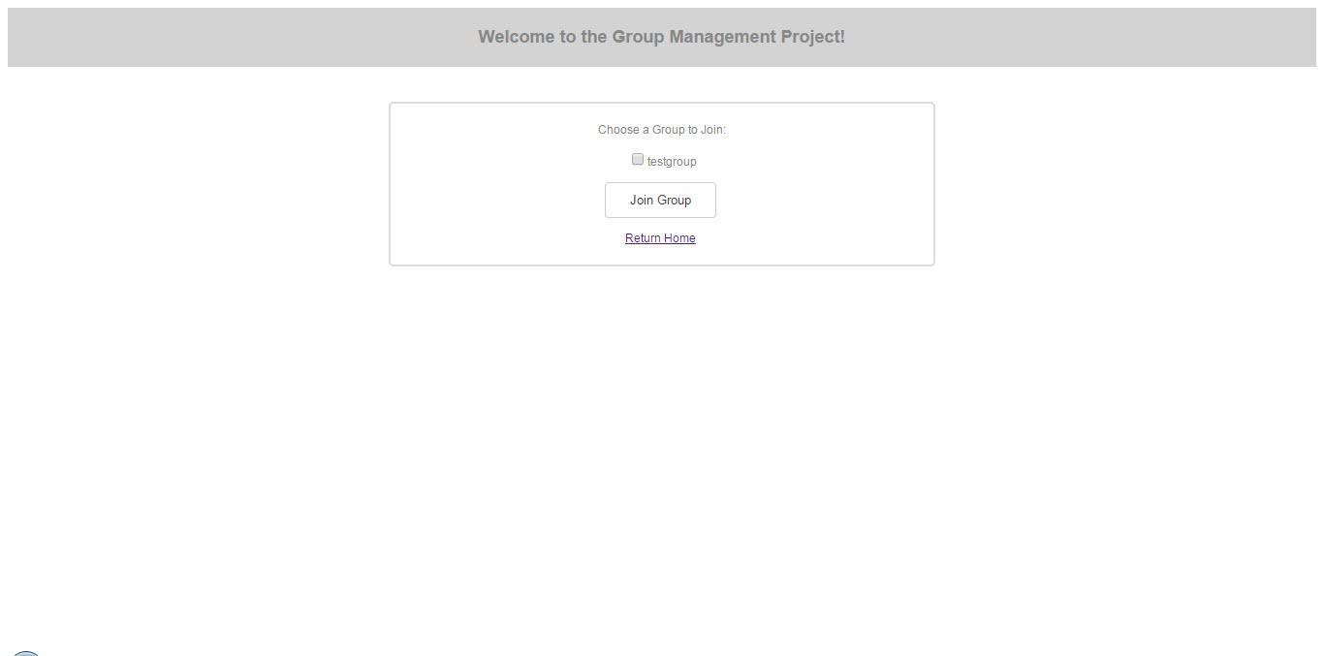

Slide 19
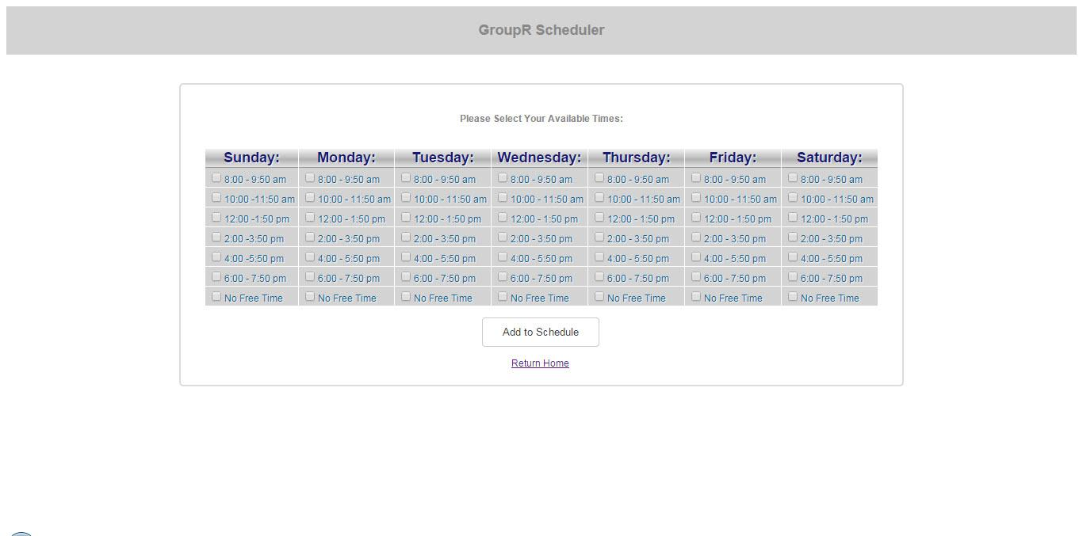

Slide 20
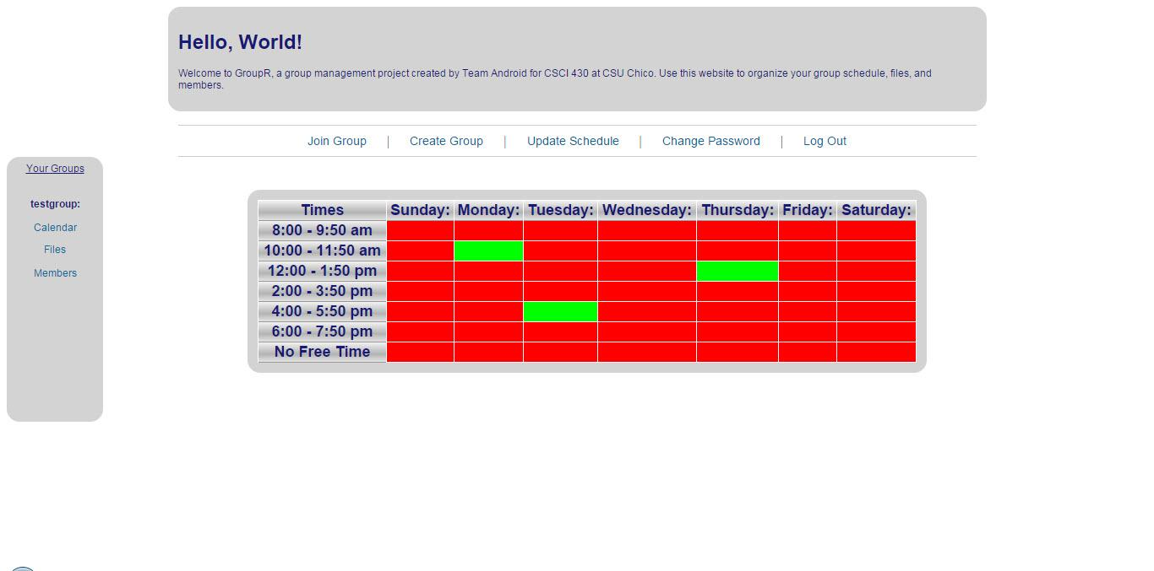

Slide 21
